Slide 1

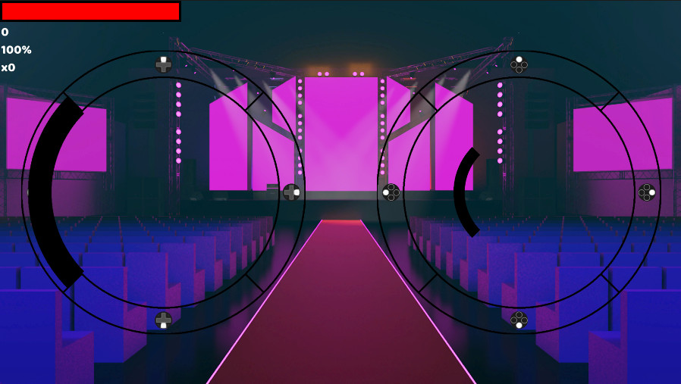
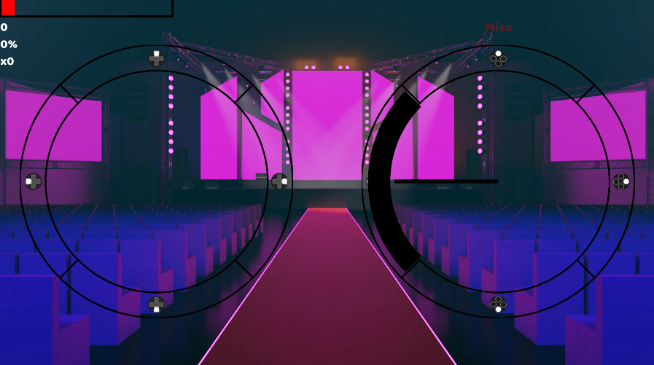
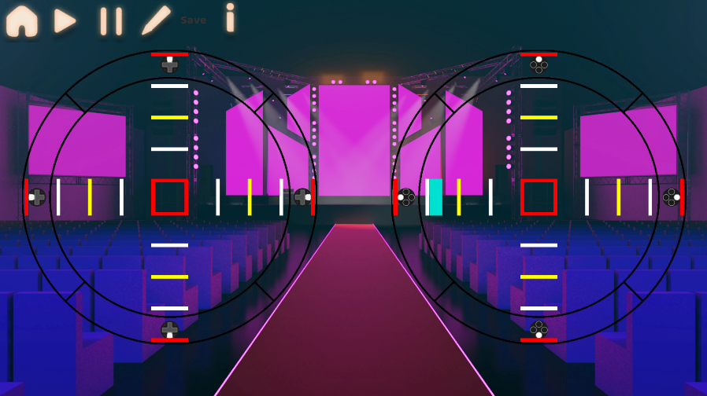

Rhythmix
Gameplay
Level Editor
The gameplay has two notes. One where players tap the button and another where they must hold and release the button.
Failure to hit enough notes will cause you to fail the level.
Compete against other players on the same map to get a higher score.
Here you can create you own levels to play by using your own music.
You can set the beat division up to 4 notes per beat allowing for high difficulty gameplay.
Theo Butler
theo.butler@students.plymouth.ac.uk
BSc (Hons) Computer Science (Game Development)

